Slide 1
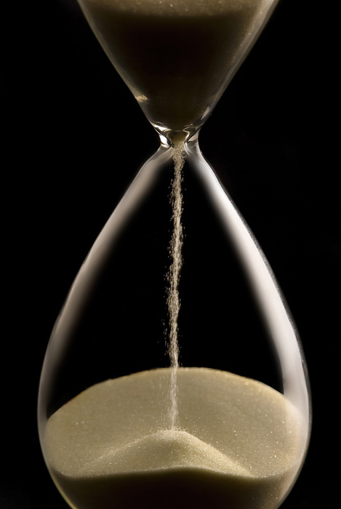
Start with
the next slide
This first slide is
not intended to be shown
A powerpoint to explain Life Expectancy.
Level: Secondary school.
Subjects: History, geography & social studies.
What you need: A computer, a screen and a projector.
The two key messages are: (1) Life expectancy is a mean and
(2) When life expectancy is low, this is mostly due to a very high child mortality.
To illustrate these points we compare the expected life spans
of 5 newborns in Burundi with those of 5 newborns in
Sweden.
Instructions and background information can be found at:
www.gapminder.org/downloads/life-expectancy-ppt
License
You are free to use and re-distribute this material for non-commercial purposes under a creative commons licence. We ask you to credit as the source: www.gapminder.org
Produced by
Mattias Lindgren, the Gapminder Foundation. Version: 2010-09-07
Photo credits
Models are used for the portraits, with the permission of the models / guardians of the models. The life spans in the examples are based on mortality statistics and do not represent the life spans of the individual models. Their names are made up for illustration only.
The 10 Swedish portraits are by Mathias Grate. The 9 Burundian portraits are by Sylvain Liechti. The Burundian landscape are from Xavier Damman (cc) http://tiny.cc/ycv7i , the Swedish landscape are from finbar_mad (cc) http://tiny.cc/urih8 . The Africa map are Wikimedia commons http://tiny.cc/kcjhm . The hour glass picture is from an unknown source. Please let us know if you have taken that picture and want to be credited, or if we have infringed on any copyright.

Slide 2
Life expectancy
… is the average
lifespan a newborn
can expect
… is short when
child deaths
are common

Slide 3
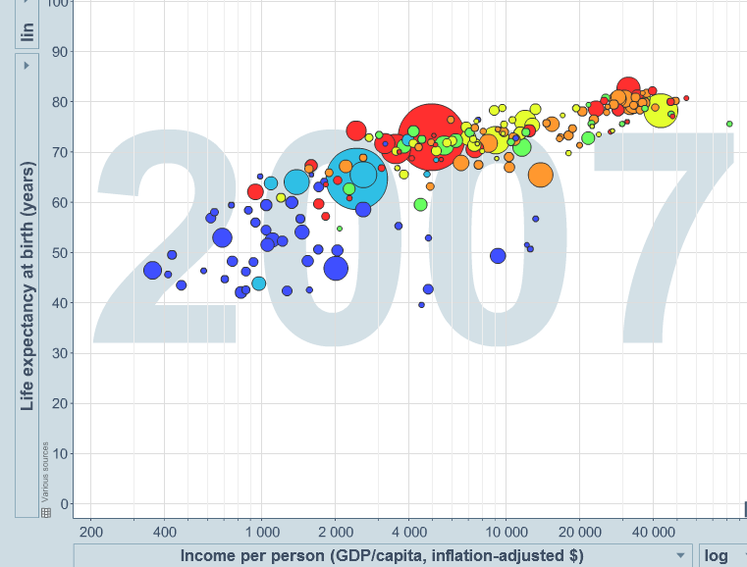
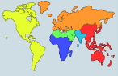
100
Sweden
Life expectancy (years)
81 years
80
60
Burundi
50 years
40
Population
(millions)
1
20
100
1000
0
200 $
2000 $
20 000 $
Income per person (comparable dollars per year)

Slide 4
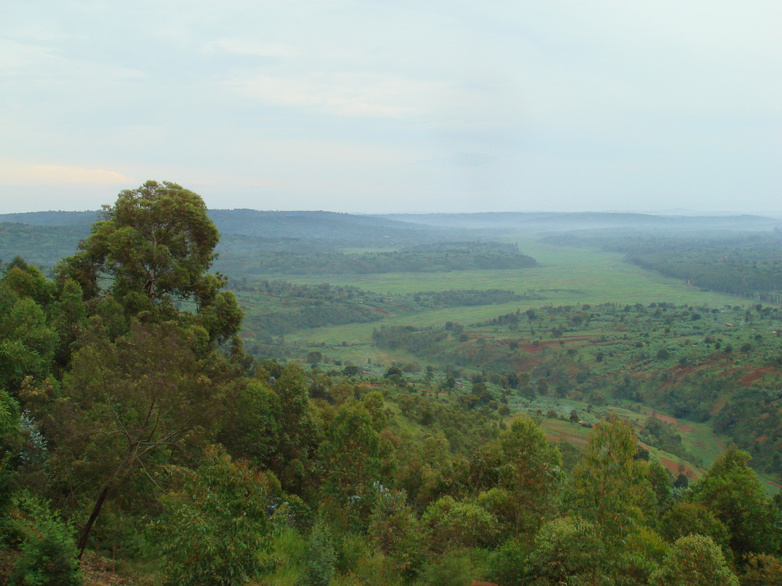
100
Burundi
Life expectancy (years)
80
60
Burundi
50 years
40
Population
(millions)
1
20
100
Can you get
old in Burundi?
1000
0
200 $
2000 $
20 000 $
Income per person (comparable dollars per year)

Slide 5
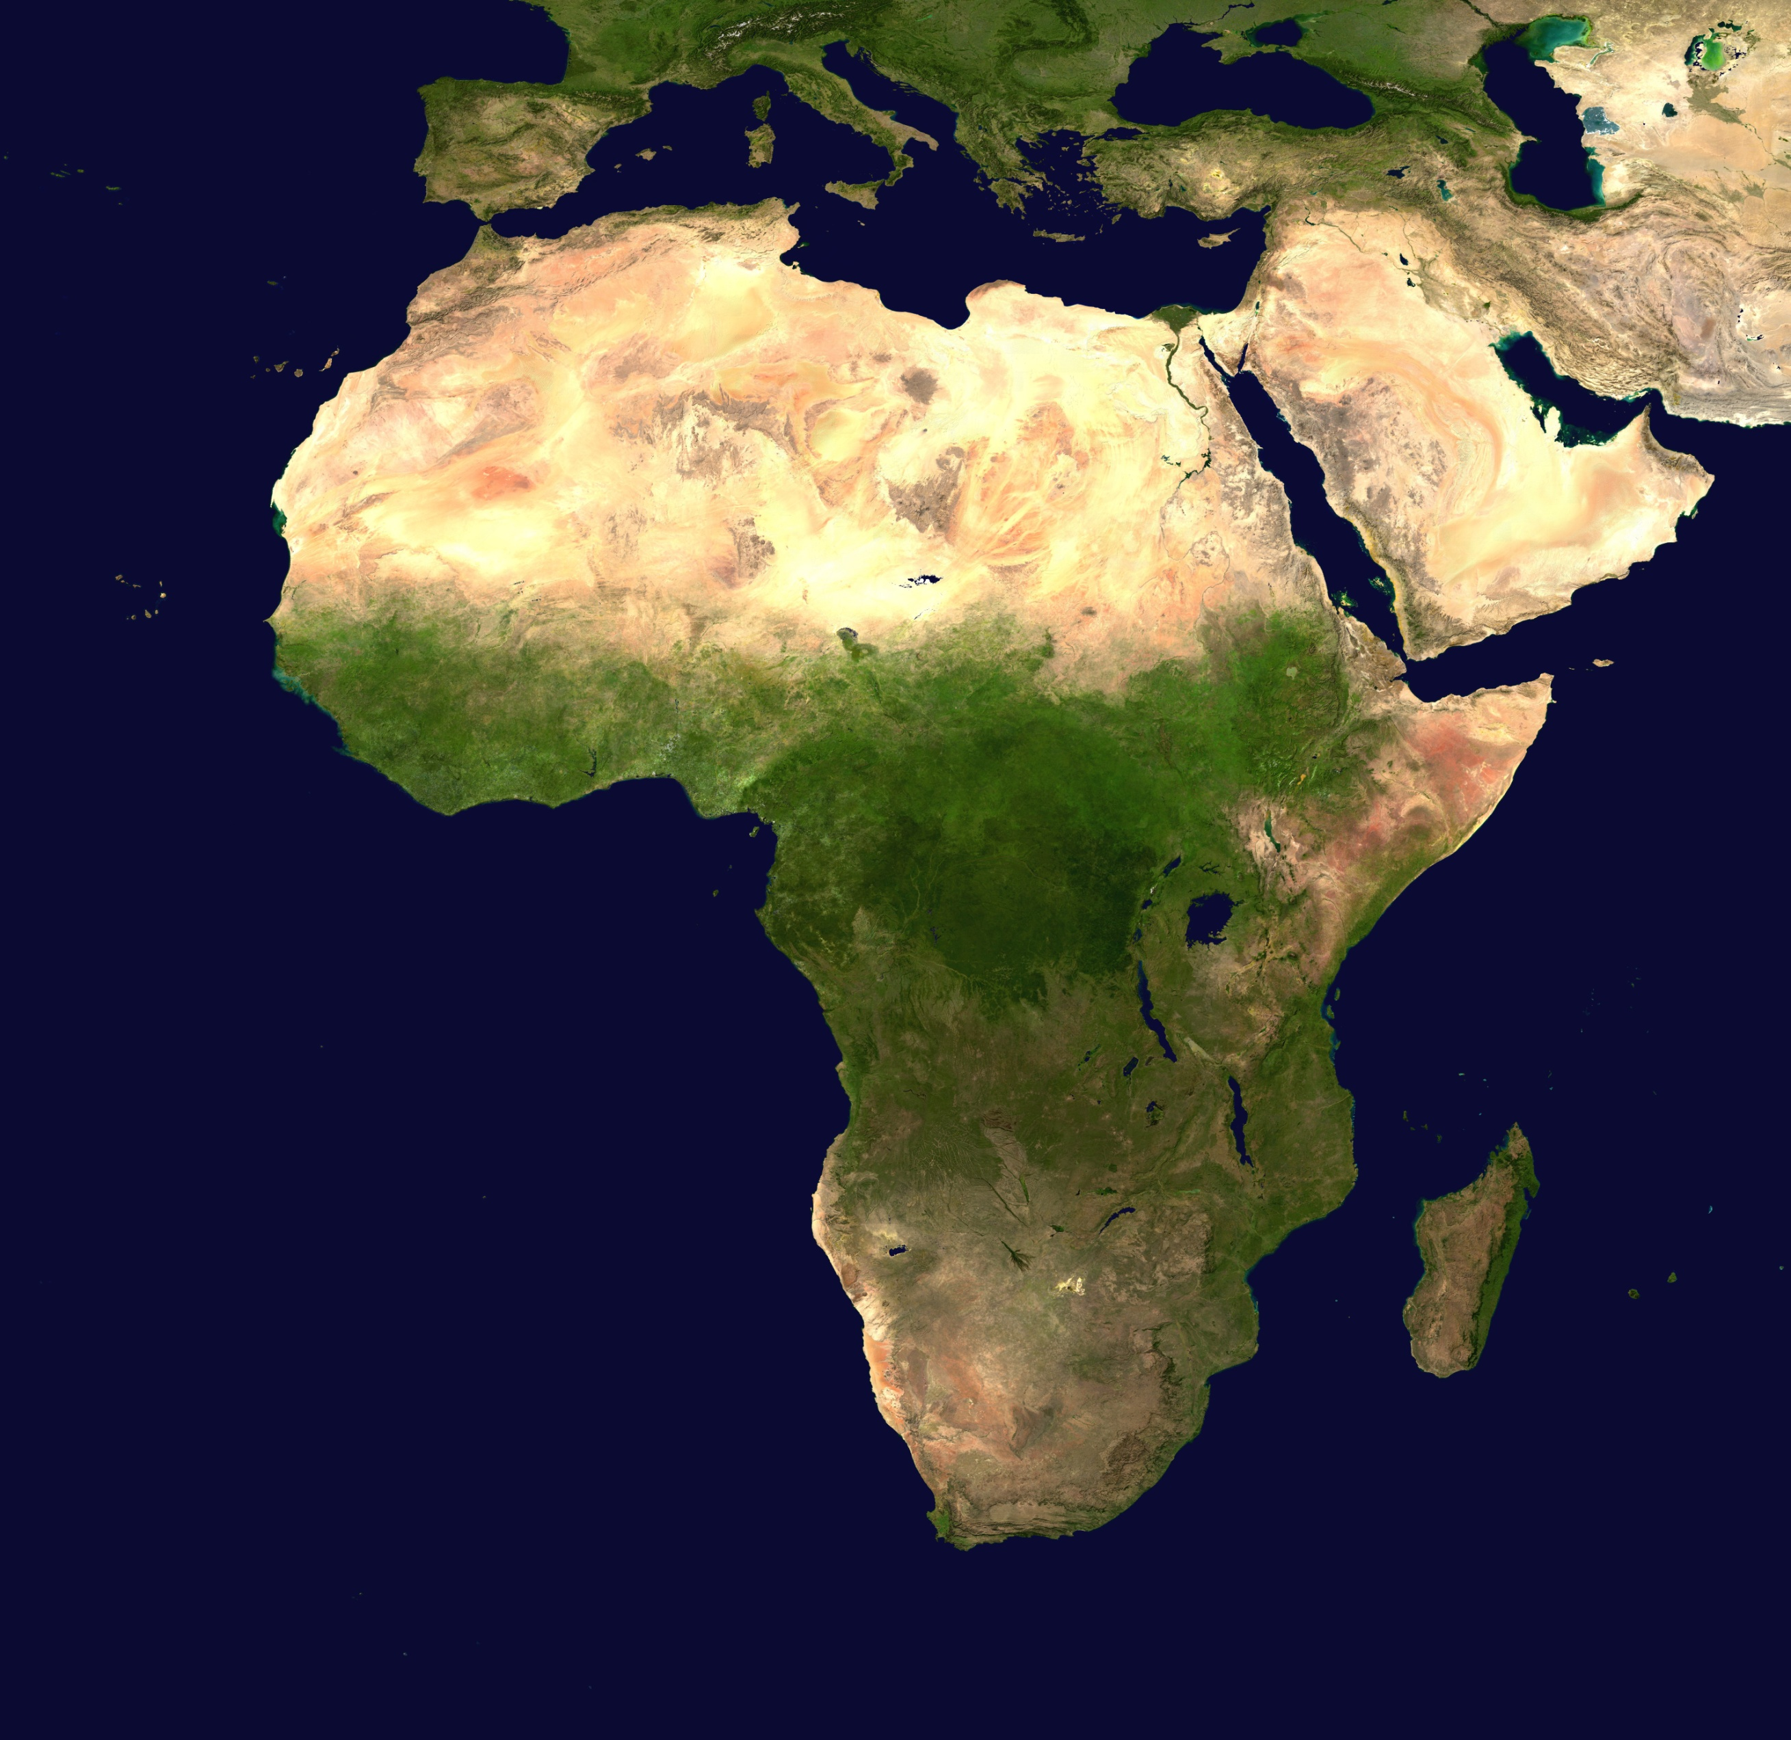
100
Burundi
Burundi
2007
2007
Life expectancy (years)
80
Age (years)
60
Burundi
50 years
40
Population
(millions)
1
20
100
1000
0
200 $
2000 $
20 000 $
Income per person (comparable dollars per year)

Slide 6
100
Burundi
2007
Look at the expected
life of five newborn
Burundians…
2007
Life expectancy (years)
80
Age (years)
60
Burundi
50 years
40
Population
(millions)
1
20
100
1000
0
200 $
2000 $
20 000 $
Income per person (comparable dollars per year)

Slide 7
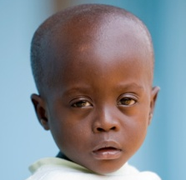
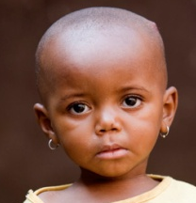
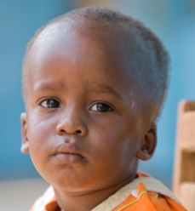
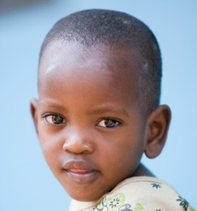
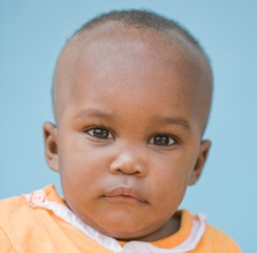
100
Burundi
2007
How long will they live…
80
Age (years)
60
…if conditions remain as in
Burundi in 2007
during their whole lifetime?
40
20
0
Pierre
Liz
Jean
Ann
Sarah

Slide 8
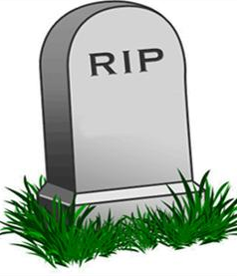
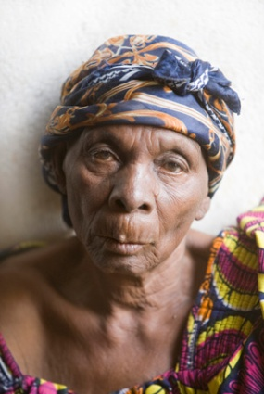
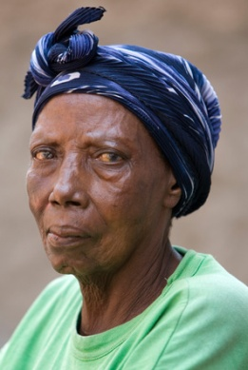
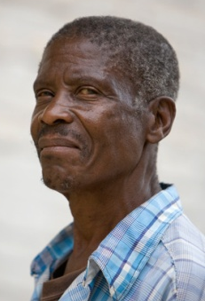
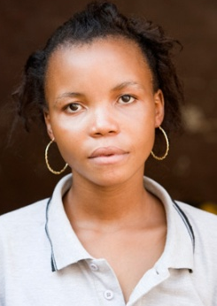
100
Burundi
2007
84
80
72
Age (years)
57
60
36
40
20
1
0
Pierre
Liz
Jean
Ann
Sarah

Slide 9
100
Burundi
old
2007
84
80
72
adult
Age (years)
57
60
36
40
child
20
So yes, 2 of 5
get old in Burundi
1
0
Pierre
Liz
Jean
Ann
Sarah

Slide 10
100
Burundi
Calculate the mean…
84
2007
This is the Life Expectancy
80
72
1+36+57+72+84
5
= 50
Age (years)
57
60
50 years
36
40
20
1
0
Pierre
Liz
Jean
Ann
Sarah

Slide 11
100
Burundi
2007
Sweden
84
Life expectancy (years)
81 years
80
72
31 years
57
60
Burundi
50 years
36
40
Population
(millions)
1
20
100
1
1000
0
200 $
2000 $
20 000 $
Income per person (comparable dollars per year)

Slide 12
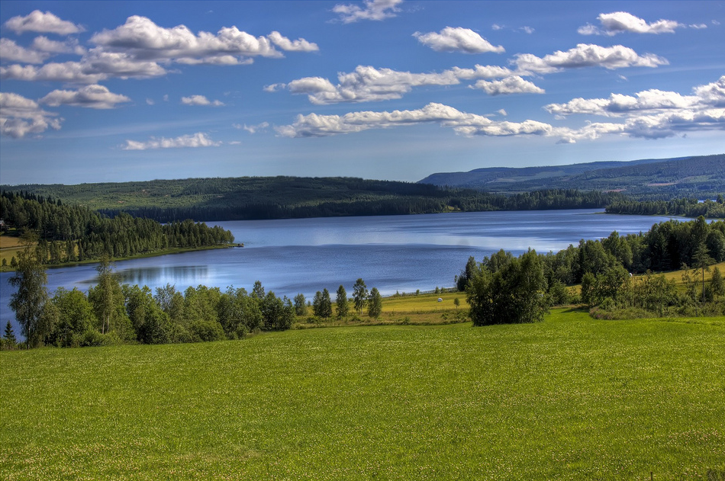
100
Sweden
Sweden
Life expectancy (years)
81 years
80
60
40
Population
(millions)
1
20
100
1000
Do all Swedes
live 31 years longer
than the Burundians?
0
200 $
2000 $
20 000 $
Income per person (comparable dollars per year)

Slide 13
100
Sweden
2007
Sweden
2007
Life expectancy (years)
81 years
80
Age (years)
60
40
Look at the expected
life of five newborn
Swedes…
Population
(millions)
1
20
100
1000
0
200 $
2000 $
20 000 $
Income per person (comparable dollars per year)

Slide 14
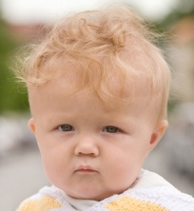
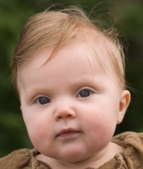
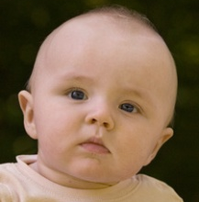
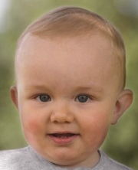
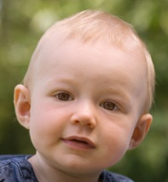
100
Sweden
How long will they live…
2007
80
Age (years)
60
…if conditions remain as in
Sweden in 2007
during their whole lifetime?
40
20
0
Per
Lisa
Jan
Anton
Sara

Slide 15
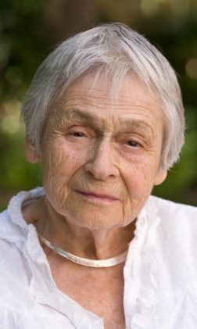
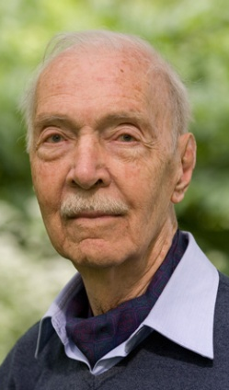
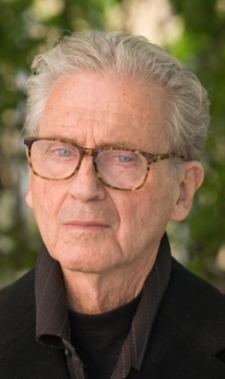
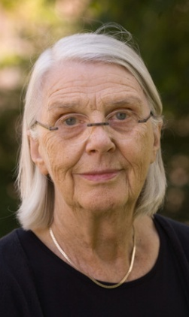
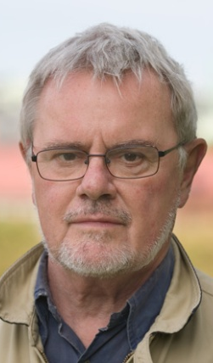
100
93
Sweden
88
2007
84
77
80
63
Age (years)
60
40
4 old
20
1 adult
0
Per
Lisa
Jan
Anton
Sara

Slide 16
100
93
Sweden
88
2007
84
77
81 years
80
63
Age (years)
60
40
Calculate the mean…
20
63+77+84+88+93
5
=81
0
Per
Lisa
Jan
Anton
Sara

Slide 17
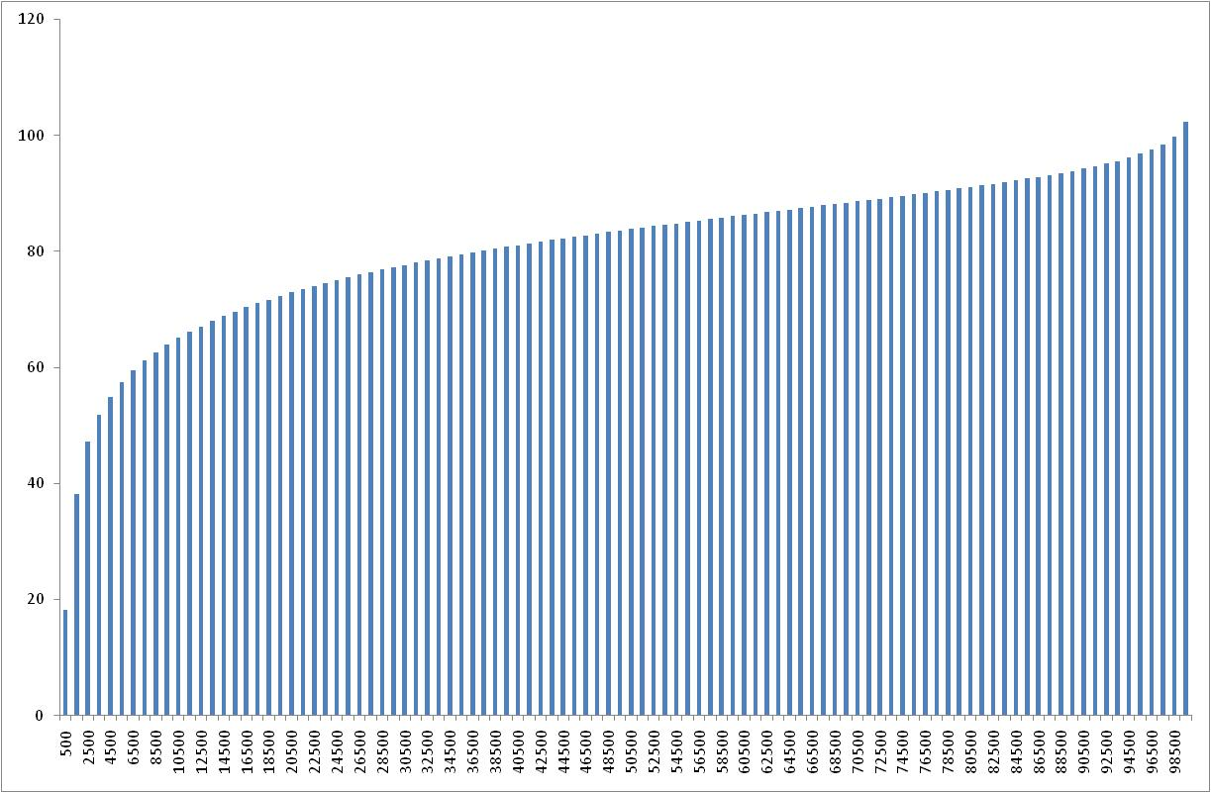
100
Sweden
2007
Sweden
Life expectancy (years)
81 years
80
60
40
Population
(millions)
1
20
100
1000
0
200 $
2000 $
20 000 $
Income per person (comparable dollars per year)

Slide 18
Let’s compare
Sweden
Burundi

Slide 19
100
Sweden
Life expectancy (years)
81 years
80
60
Burundi
50 years
40
Population
(millions)
1
20
100
1000
0
200 $
2000 $
20 000 $
Income per person (comparable dollars per year)

Slide 20
100
2007
81
80
Age (years)
60
50
40
20
0

Slide 21
100
“To live long” in Sweden
is almost the same as
“to live long” in Burundi
2007
80
Age (years)
60
So, no,
all Burundians do not live 31 years shorter than Swedes
40
20
But “dying young” in Sweden
is very different
from “dying young” in Burundi
0

Slide 22
Life expectancy
… is an average
-Most Burundians get older than 50
-Some die in childhood
… is low when child-
deaths are common
-It is low in Burundi
not because all die a bit earlier
-But because
some die much younger

